Slide 1
Magellan: Toward Building Entity Matching Management Systems
Authors: Pradap Konda et al.
Presenter: Baran Kaya

Slide 2
Outline
Introduction
Entity Matching & Systems
Magellan
Tools & Guides
Open-World System
Experiments/Results
Summary

Slide 3
Introduction
Entity Matching (EM) → Big challenge in Data Management
Lots of new matching algorithms
Magellan → EM System
How-to guides
EM pipeline tools
Data Analysis & Big Data
Python
Data cleaning
Information extraction (IE)
Visualization
Learning
Scripting environment
Notes:
One of the biggest and longest challenge in DM
There are lots of new algorithms for EM but no EM systems
What to do in each EM scenario, step-by-step
Tools to help these steps for entire EM pipeline
DA and BD stacks in Python for
Interactive experiment env. with scripting

Slide 4
Introduction
What features should the EM system have?
1. Many steps (pipeline)
Blocking, matching, exploring, cleaning, debugging, sampling, labeling, estimating accuracy, …
2. Many techniques
Learning, mining, visualization, outliner detection, information extraction (IE), crowdsourcing, …
3. Interactive script language
Lacking functionality & system integration
4. Guides about EM scenarios
Which approach user choose?
Notes:
Users need many steps for EM. Current systems don’t have most of them.
EM steps uses many methods but current systems don’t have them. Current approach: Move data between different systems (time consuming).
Rapid prototyping and iteration.
Lots of EM algorithms, which is best for them?

Slide 5


Introduction
Magellan:
Step-by-step guides
Tools to help each step
Built on top of Python Data Analysis and Big Data stacks
Open-world system
Notes:
Magellan integrated with Python ecosystem. Which is great because Python has lots of data related packages and new ones keep coming.
Closed-world system (stand-alone, monoliths) VS Open-world system
Relies on eco-system for full support EM

Slide 6
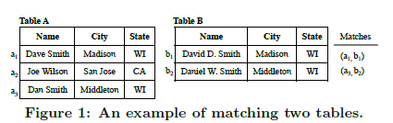
Entity Matching
Data instances that refer to the same real-world entity
Research focus:
Matching accuracy
Run time (performance)
Blocking: remove non-matched pairs
Faster comparison
Subset of attributes
Different color products
Record Linkage OR Data Matching
Notes:
Blocking: comparing all records require time.
Selecting
subset of the attributes for
faster comparison.

Slide 7



Current EM Systems
Non-commercial: D-Dupe, DuDe, Febrl, Dedoop, …
Commercial: Tamr, Data Ladder, IBM InfoSphere, …
Doesn’t cover entire pipeline
Doesn’t support outside methods
Poor script/code support
Little or no guidance
Notes:
Non of the 33 systems have debugging and sampling
Learning, crowdsourcing, keyword search, … (Ex. User wants to clean a keyword or extract a column)
Only 5 out of 33 systems provides with R and Python
Most of the case user doesn’t know what to do next.

Slide 8

Next EM Systems
Next EM systems should:
Have how-to guides
Reduce user burden
Reduce runtime
Be easily expandable
Notes:
2. Rich set of tools to help
3. Scale tools up to large data
4. Extent with existing or future method
4. Current EM’s don’t support all domains. New domain addition would be easier.

Slide 9
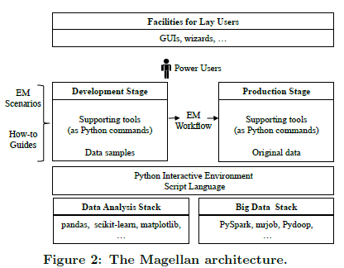
Magellan
Entity Matching Management System (EMMS)

Slide 10


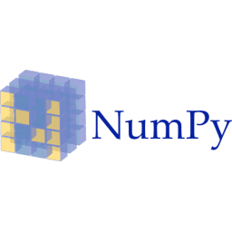


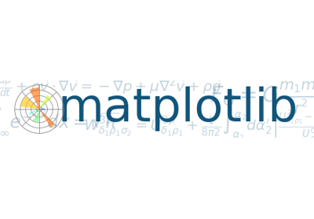

Magellan
Magellan has 2 stages:
Entity Matching Management System
Development stage
Data samples
Improve accuracy
Data analysis
Python DA stack
Production stage
Entire Data
Big Data
Python BD stack
Notes:
They could choose either R or Python but they believe IT community more familiar with Python.
Tools:
DS: numpy (numerical/array operations), pandas (relational DM), matplotlib (visualization), scikit-learn (ML)
PS: Pydoop, mrjob, PySpark

Slide 11
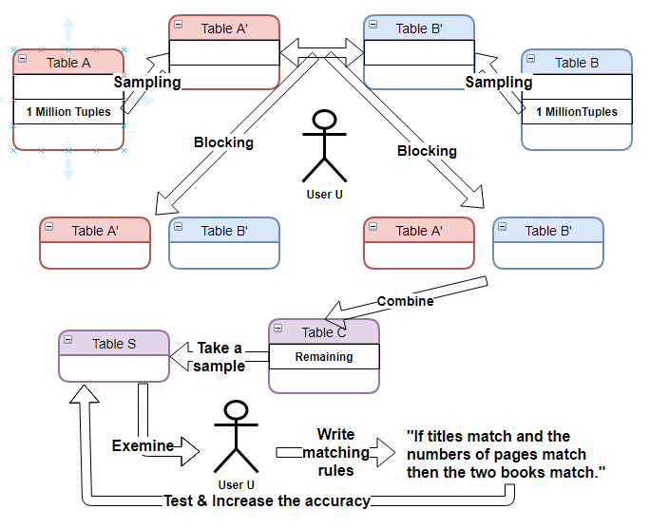
Magellan
Entity Matching Management System
Development Stage

Slide 12
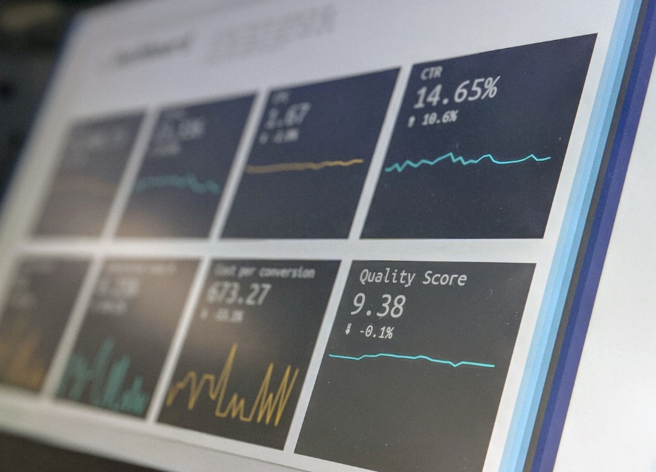

Magellan
Matching 2 tables:
Supervised learning
Rules
Learning + Rules
The authors realized that developing:
Effective guides
Tools to support guides
Open-world system
Entity Matching Management System
Notes:
Developing effective how-to guides, even for very simple EM scenarios such as applying supervised learning to match is complex/difficult.
EM consists of different steps (loading data, sampling, labeling, …) and it raises its difficulty.
They start with only supervised learning development stage.

Slide 13
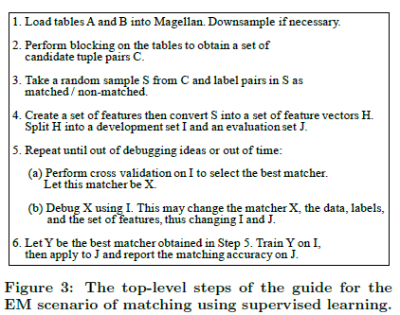
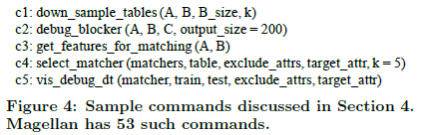
Tools & Guides
Downsampling
Blocking
Label a sample
Use sample to iteratively find/debug matcher
Return matcher & accuracy
Notes:
The guide states that to match two tables A and B, the
user should load the tables into Magellan (Step 1), do block-
ing (Step 2), label a sample of tuple pairs (Step 3), use
the sample to iteratively find and debug a learning-based
matcher (Steps 4-5), then return this matcher and its esti-
mated matching accuracy (Step 6).

Slide 14
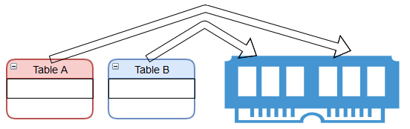
Loading & Down sampling
Load tables into memory
Random sampling ➔ Few matches
Select B_size tuples from B to B’
Find k/2 matching elements from A
Randomly select last k/2 for A’
Aim: Increase match probability
Tools & Guides
Downsampling
100k+ 100k+

Slide 15
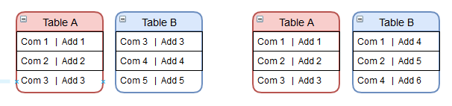
Loading & Down sampling
A’ and B’ should represent A and B
Example:
Case 1: Same name & address
Case 2: Same name but different address (branch)
A’ and B’ contains Case 1 but no/few Case 2
More Sophisticated Downsampler
Clustering → Tuple groups
Analyze groups → Get samples
Tools & Guides

Slide 16

Blocking & Candidate Tuples
Blocking: Remove non-matched tuple pairs
Should automate blocking
3 cases:
Know which matcher to use (Automate)
Don’t know which matcher & have labeled tuple pairs (Blocking automated, User debugs)
Don’t know which matcher & don’t have labeled tuples
How to choose the best blocker?
How to debug it?
When to stop?
Tools & Guides
Notes:
The user still has to debug the blocker to check that it does not accidentally remove too many true matches.

Slide 17

Blocking & Candidate Tuples
Selecting the best blocker
Suggestions based on data domain
Matching books with ISBN
Try a few blockers, choose best accuracy
Debugging blocker
When to stop?
Stop when A’ and B’ blocking results fit into memory
A and B cannot fit
Stop when debugger has no/few matches
Tools & Guides
Notes:
If U finds many matches in the list, then that means blocker L has removed too many
matches. U would need to modify L to be less “aggressive", then apply the debugger again.

Slide 18

Sampling & Labeling
Tools & Guides
User labels tuples in S: Matched or No-matched
Random sample → May be no/few matches
If C and S have less matched → user spent time
User labels a few tuples
Enough matches in S → Continue labeling
Not enough → Restart blocking

Slide 19
Matcher Selection
Matchers: Decision tree, Naïve Bayes, SVM, …
Automated process
C3: Creates features from A’ and B’ attributes
User converts S to feature vector
C4: Cross validation for all matchers
Return best accuracy and highlight closest
Tools & Guides

Slide 20
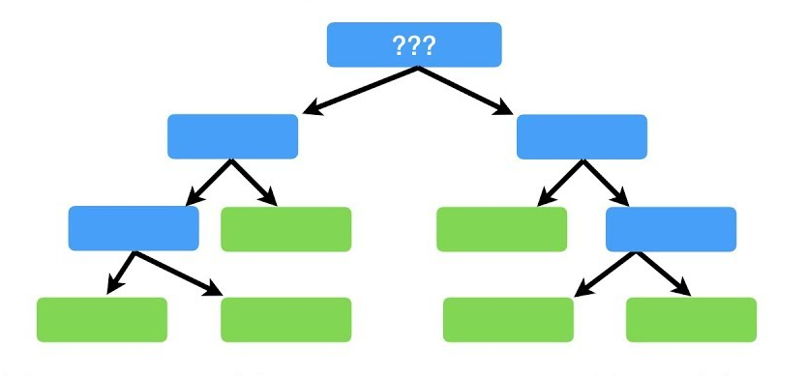

Matcher Debugging
User debugs in 3 steps
1. Identify matching mistakes
Dirty data
Wrong label
Misleading features
Algorithm problem (tree search depth)
2. Categorize mistakes
3. Fix common categories
Data cleaning
Information extraction (IE)
Proxy debugging
Tools & Guides
Notes:
Matcher has no debugger or not effective. Train another matcher that has debugger show problems.
User can identify data, label problems but not algorithm ones.

Slide 21
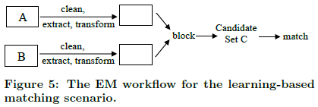
EM Workflow
Tools & Guides
After development stage → production stage
Scenario 2: Rules to match
Create rules manually
Use labeled data for rules
Use active learning for rules
Scenario 3: Learning + Rules
First learning then rules
Notes:
steps of sampling and labeling a sample S do not appear in this workflow, because we need them only
in the development stage, in order to create, debug, and train matchers.

Slide 22
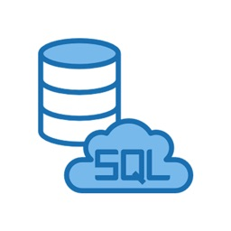

Open-World System
RDBMS ➔ Closed-world systems
OWS expects:
Other systems can manipulate its data
It can manipulate other systems’ data
Data structures / Store tables:
Data frame (pandas)
MTable (data frames, metadata)
MDataFrame
Metadata: Keys, dates, ownerships
Store in a central catalog
Verifies only when required → Update alert
Notes:
Data frame: no metadata (keys, dates, ownership)
Other system can easily manipulate data frame data type.
Other system can change tables but not metadata.
Key deleted when update?
Invalid – Alert user

Slide 23


Experiments
44 students & 3 companies
Students used web data
Domains: Movies, vehicles, books, restaurants, …
Average tuples: 7313
Attributes: 5-17
Precision goal: at least %90

Slide 24
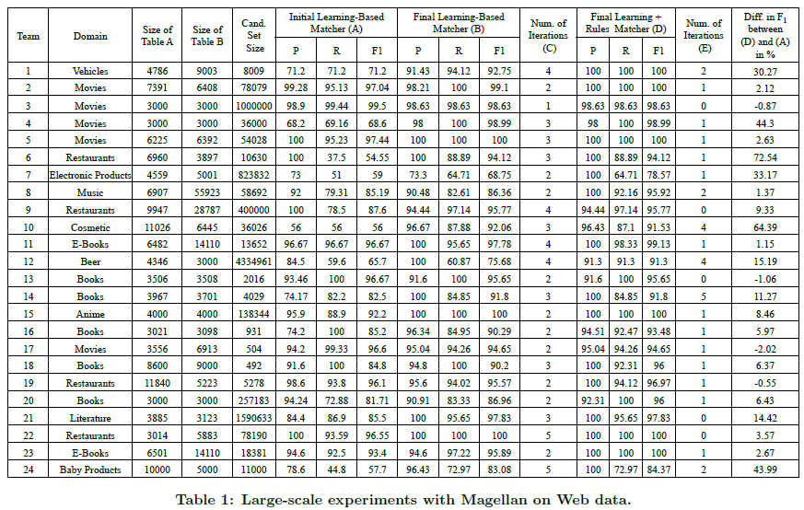
Experiments

Slide 25
Experiments Results
90+% precision
20 teams: 90+% recall
Average blockers: 3 (1-5)
Average blocker iteration: 5 (1-10)
Average blocking accuracy: 95%
Data cleaning: 12
4-32 hours on blocking (+documentation)
Average 3 matcher debugging (1-5)
19 teams added 1-5 rules (1-5 iterations)
Average hours spent: 12 (5-50)
Company experiments: Outgoing

Slide 26
Summary
Lots of EM algorithms, fewer EM systems
Current EM systems are limited
Magellan
How-to guides
Tools support
Open-world system
Students and organization experiments
Notes:
We argue that far more efforts should be devoted to building EM systems, to significantly advance the field.
We discuss four limitations that prevent current EM systems from being used extensively in practice.

Slide 27
THANK YOU!
REFERENCES
Konda, Pradap, et al. "Magellan: Toward building entity matching management systems." Proceedings of the VLDB Endowment 9.12 (2016): 1197-1208.
PICTURES
To-Do list: Photo by Glenn Carstens-Peters on Unsplash
Numbers: Photo by Mika Baumeister on Unsplash
Post-its: Photo by Kelly Sikkema on Unsplash
Graphs: Photo by Stephen Dawson on Unsplash
Books: Photo by Patrick Tomasso on Unsplash
Stop: Photo by Will Porada on Unsplash
Glass: Photo by Yasin Arıbuğa on Unsplash
Laptops: Photo by Marvin Meyer on Unsplash

